Slide 1
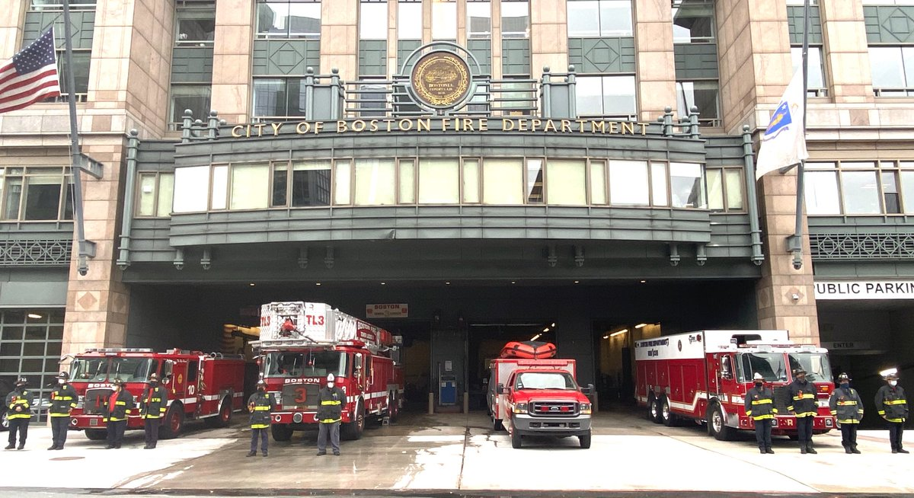
Prajakta Sable
City of Boston Fire Analysis

Slide 2
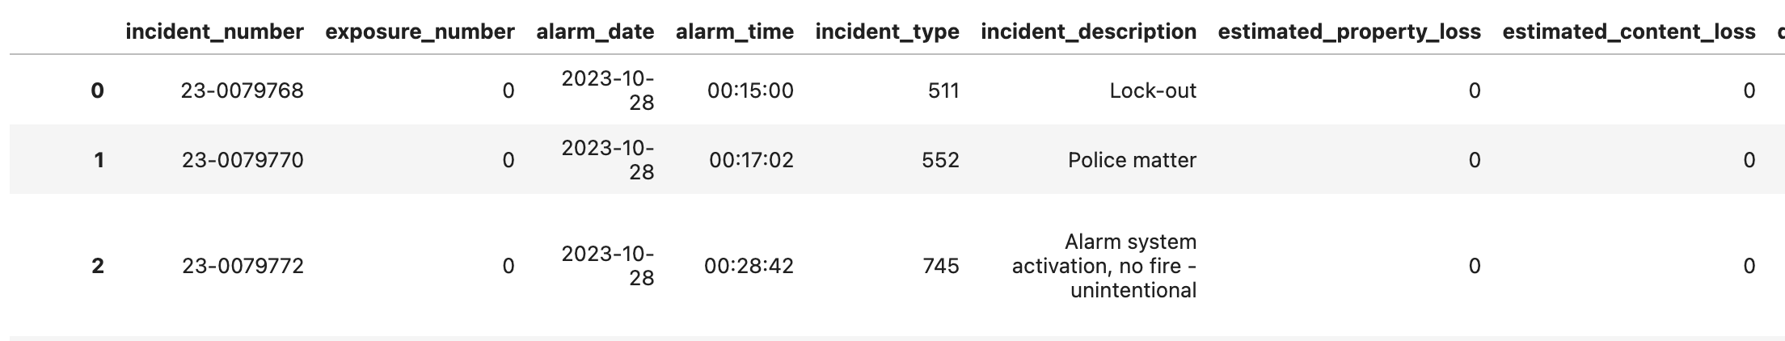
Introduction
2014: 41,433
2025: 46,677
2016: 42,553
2017: 47,313
2018: 50,304
2019:49,670
2020: 92215
2021: 96476
2022: 101976
2023: 96635
City of Boston Fire Reporting publishes data Every year
Count of Fire accidents per year
–
What are the top 10 fire accident trends?
What’s the most popular fire area in Boston?
What’s the yearly trend of incidents?
Which time of day do most incidents happen?
Predicting 2024 number of fires using Time Series in Machine Learning
Yearly Incident Property loss
–
–
–
–
Fire categories
~ 55,000
Fire per year Approx
The date when the alarm was raised for the incident.
Target variables
estimated cost of property damage due to the incident.

Slide 3
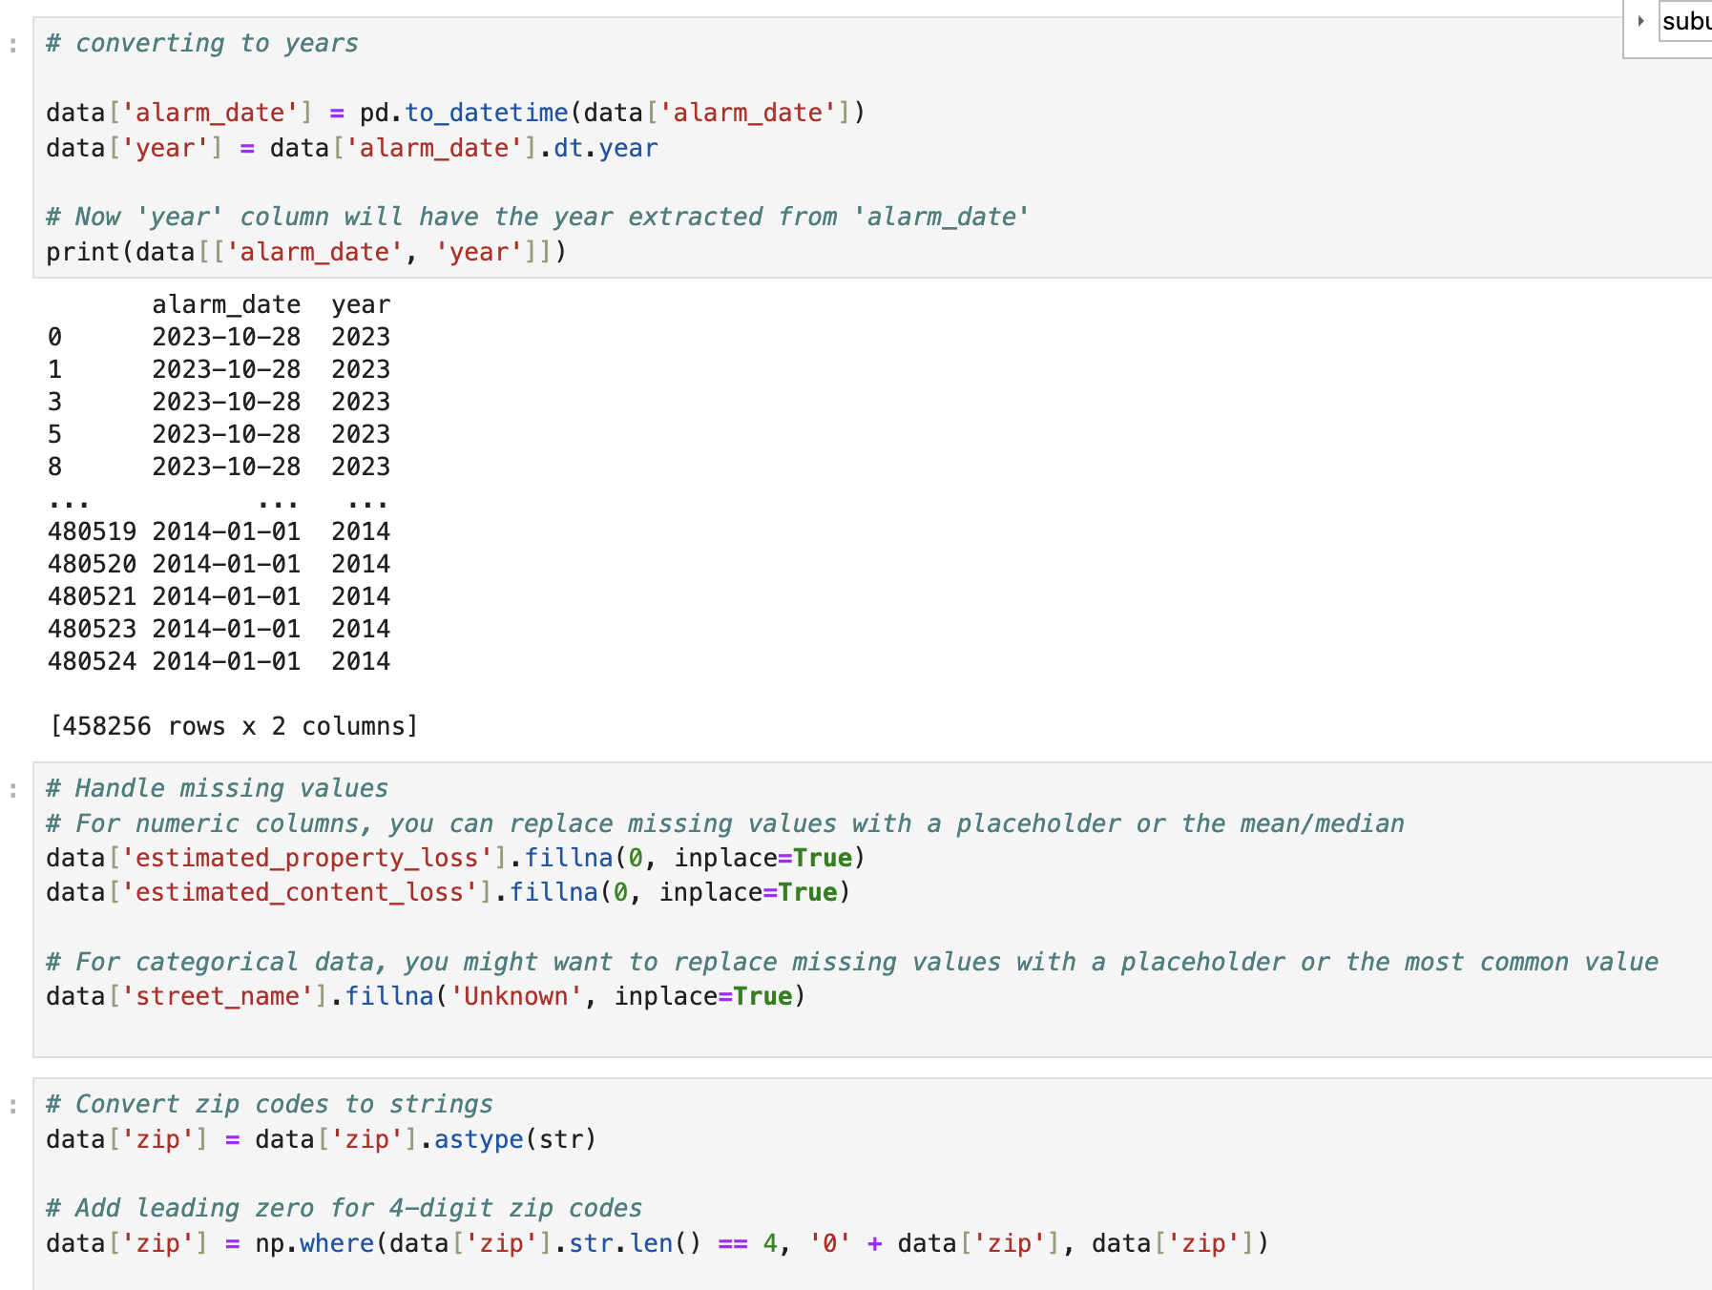
Data cleaning was needed for a few Places:
Dropped Unnecessary Columns
Handled Missing Values
Date-Time Conversion: Transformed 'alarm_date' into a DateTime object for better temporal analysis and extracted the 'year' for annual trend evaluation.
Standardized zip codes by adding leading zeros where necessary.

Slide 4
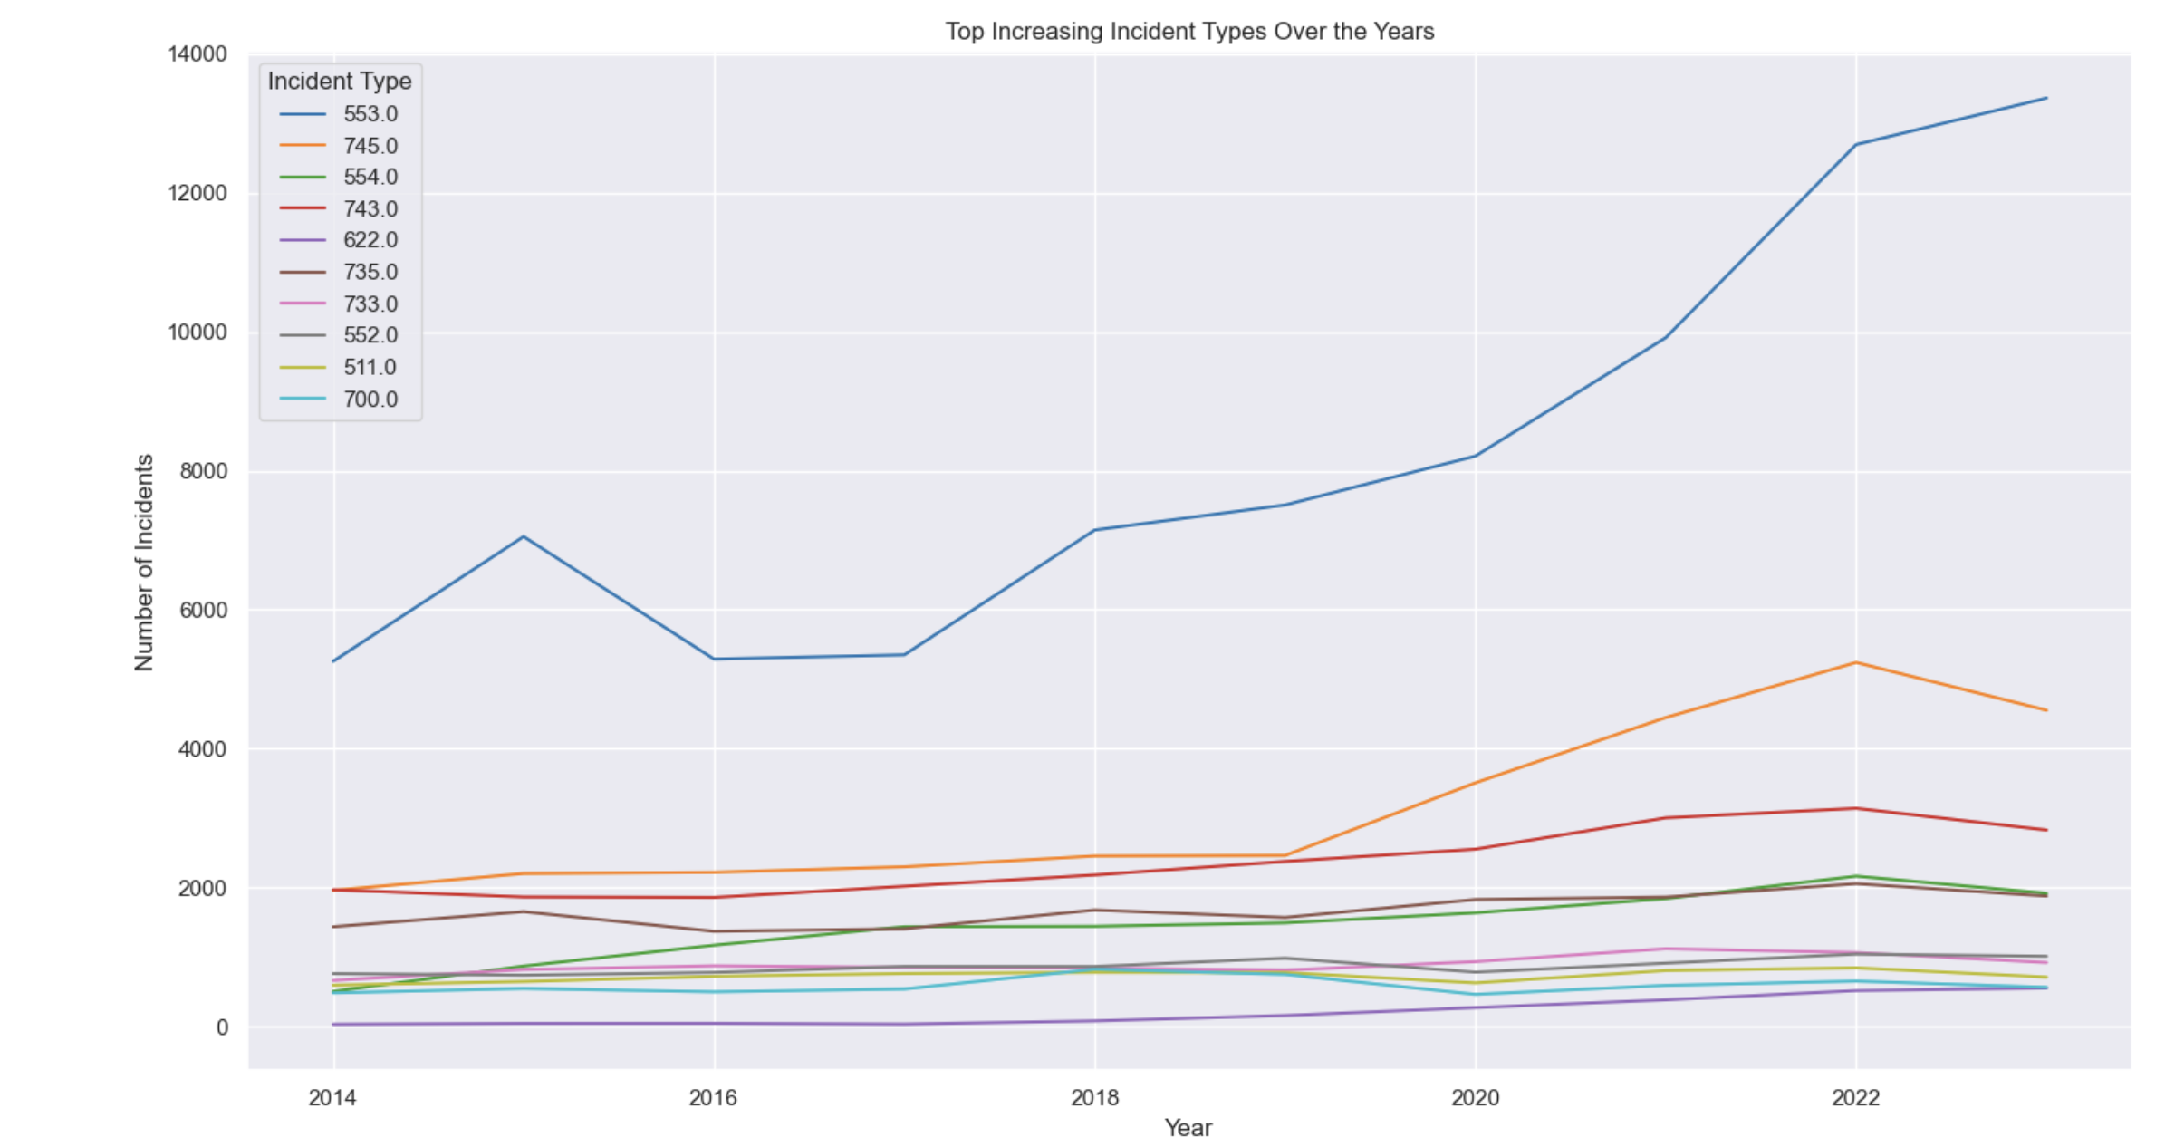
Top 10 Frequent Fire incidents trend
The graph shows a line chart for the top 10 incident from 2014 to 2022, indicating the most frequent types of incidents reported. According to NFIRS incident code, 553, which is ”Public service”, has the highest count, suggesting it is a common occurrence

Slide 5
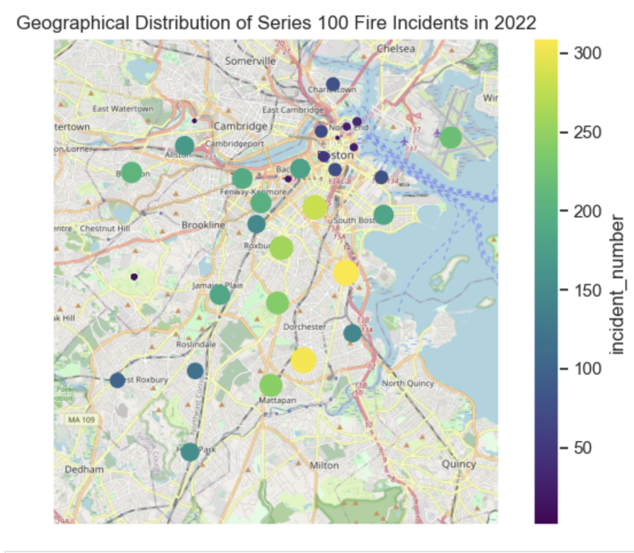
What’s the most frequent fire area?
100 Series incidents had Fire, which is more dangerous.
Each circle represents a specific location of an incident, with the size correlating to the number of incidents at that location—the larger the circle, the higher the number of incidents reported.

Slide 6
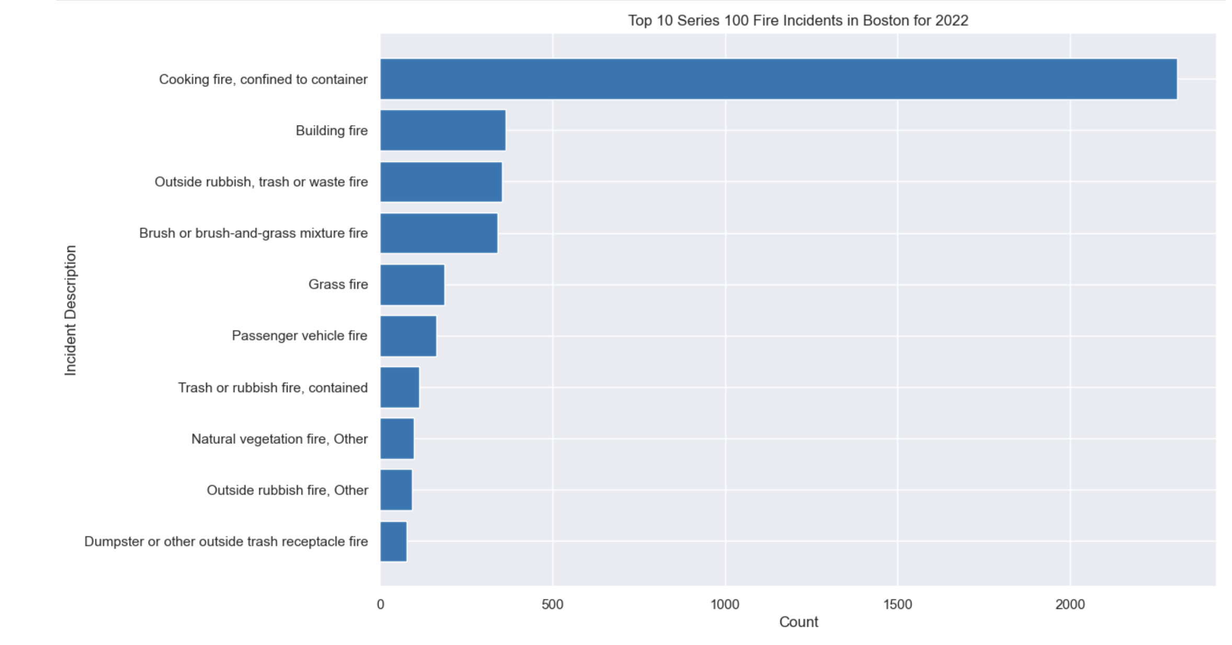
Top 10 Fire Incident Types in Boston for 2022

Slide 7
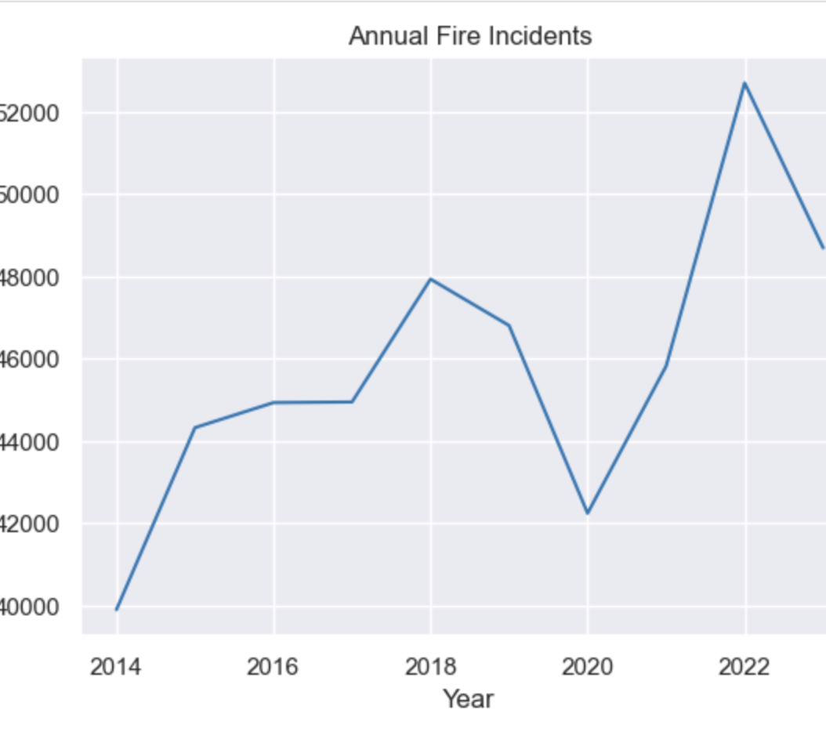
Yearly Trend of Fire Incidents
The line graph depicts the annual number of fire incidents reported from 2014 to 2023. There is a general upward trend in the number of incidents over the years, with some fluctuations. Notably, there's a sharp increase in incidents after 2020. The reasons behind these trends could be multifactorial, including pandemics, lockdowns, or other external factors.

Slide 8
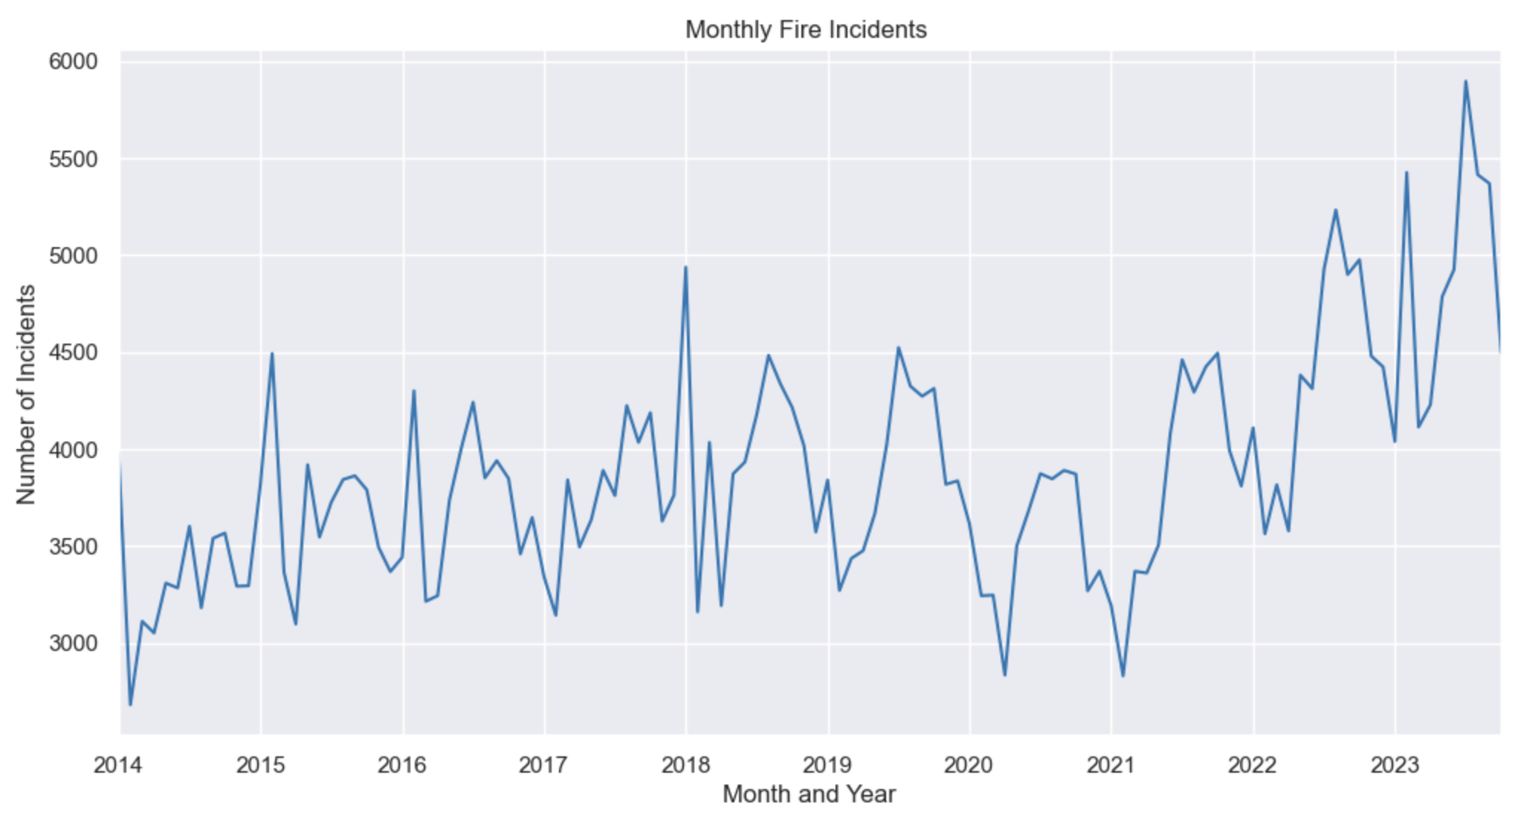
What are the Monthly fire accidents look?
This chart shows seasonal variation with peaks from 2014 to 2023.
Generally, more incidents happened in the mid-year.

Slide 9
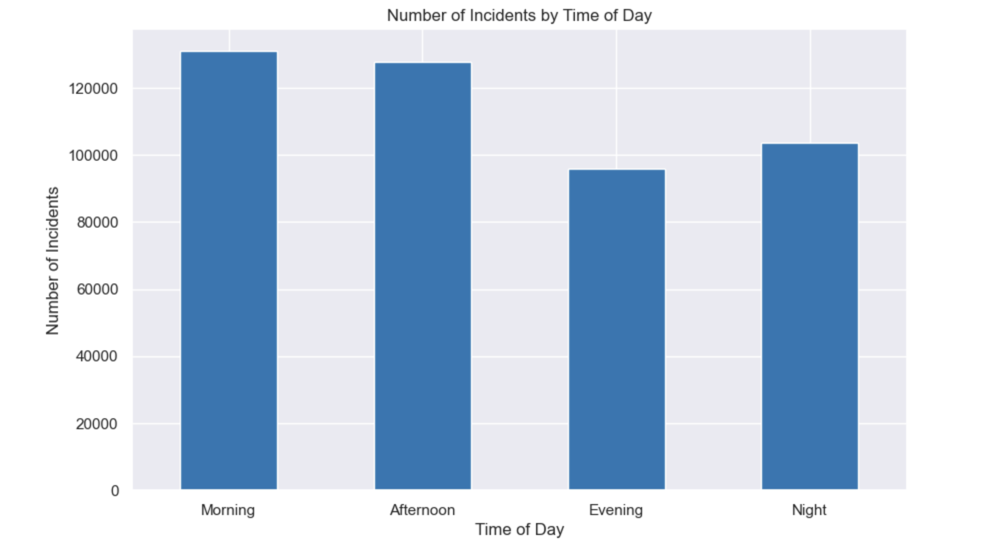
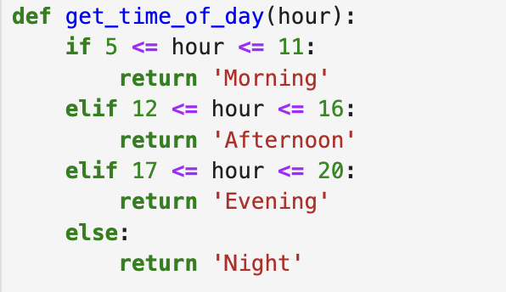
Which time of day do most incidents happen in a day ?
The Morning and afternoon experience more fire incidents than the others.

Slide 10
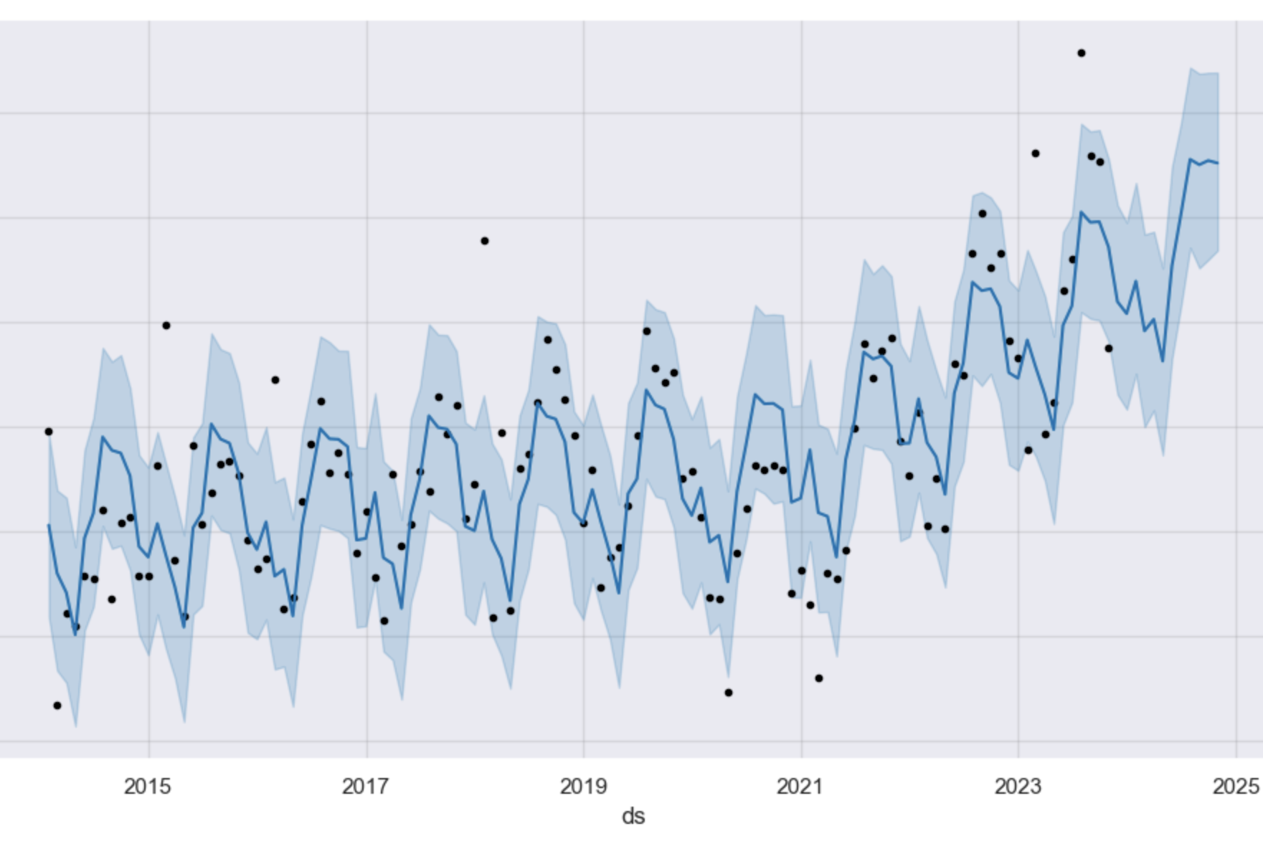
The estimate incident number in 2024

Slide 11
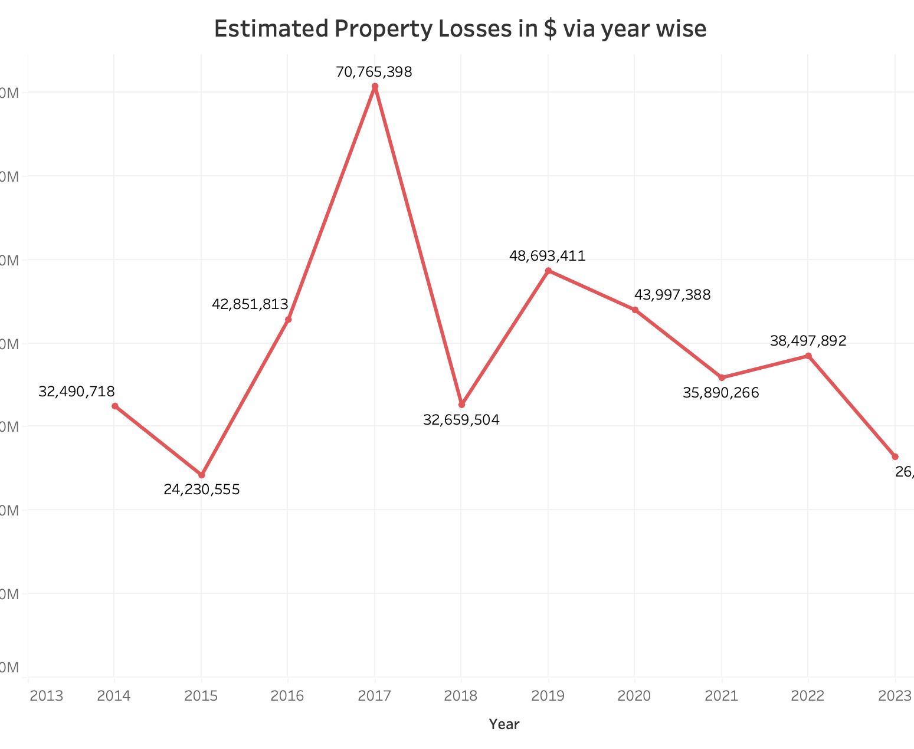
Yearly Incident Property loss
A significant spike in losses occurred in 2017, reaching the highest point at approximately $70.8 million.
Dorchester Apt fire 2017.

Slide 12
Strategies
Prevention: More fire incidents will happen in July, and August 2024. Discover: Pay attention to the building where is nobody living or under construction.
Education: Leverage findings to educate the public on fire prevention during peak times through workshops and drills.
Action:the incident type field, consistency was quite high (>80%) for the cooking fire incidents.

Slide 13
Recommendations to improve fire cause reporting
Data quality: NFIRS data quality issues, this report focuses on a single field, the incident type, a field that is both important in its own right and shares structural features with other fields, including a large number of codes and subgroupings of codes by topic headings
Fewer codes using broader categories combined with optional narrative text fields for details
Options for reporting via smartphones and tablets
Examples of model reports for different types of incidents
Optional interview-style data entry that walks fire personnel through the reporting process
Rigorous testing for validity, reliability, and usability.

Slide 14
Thank you !

